Slide 1
Chapter 17-2 Optional
How to use Bootstrap, Templates & Themes
Notes:
Session: Ghi số thứ tự session trong môn học
Session Name: ghi tên của session sẽ dạy
<number>

Slide 2
Objectives
An introduction to bootstrap
How to use bootstrap to design a responsive website
Website templates and themes
Notes:
Mô tả nội dung mà học viên phải đạt được khi kết thúc môn học này
<number>

Slide 3
Introduction to Bootstrap
Notes:
Cần nghiên cứu kỹ hơn về Bootstrap
<number>

Slide 4
What is Bootstrap?
Bootstrap is the most popular HTML, CSS, and JS framework for developing responsive, mobile first projects on the web.
Created by Twitter, published as open source
Consists of a CSS file, a JS file, and an icon font
CSS is compiled from LESS source
JS can be loaded in “everything” version or only selected pieces

Slide 5
Mobile-First Strategy
Content
• Determine what is most important
Layout
• Design to smaller widths first
• Base CSS addresses phones; media queries for tablet and desktop
Progressive enhancement
• Add elements as screen size increases

Slide 6
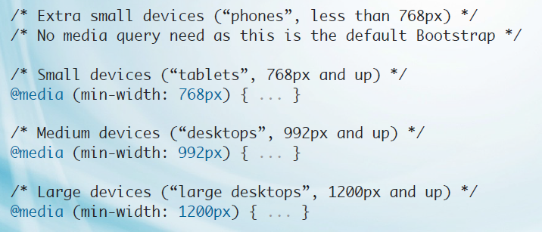
Bootstrap Break Points

Slide 7
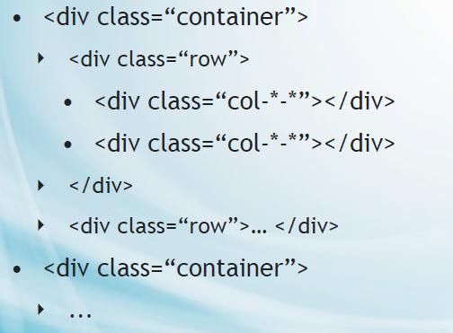
Basic Grid Structure
Bootstrap divide desktop screen to 12 column. And you define your column are multiple of 1/12.

Slide 8
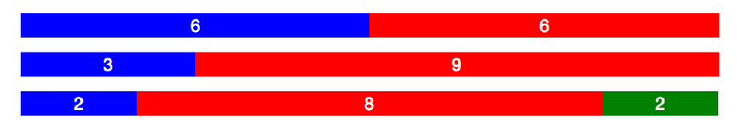
Example 1

Slide 9
Example 2

Slide 10
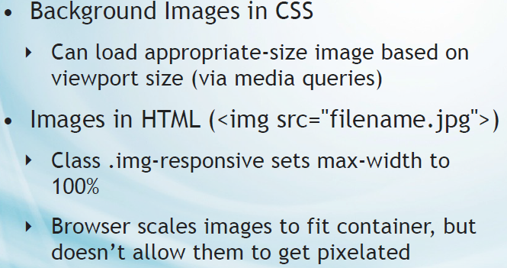
Responsive Images

Slide 11
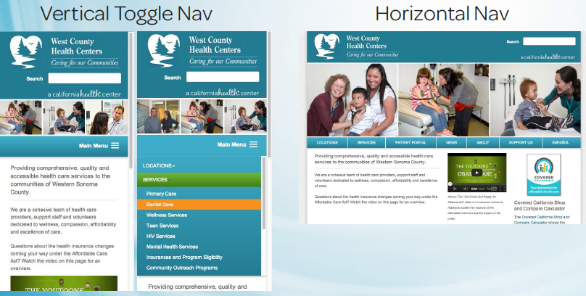
Navigation

Slide 12
Demo using bootstrap
How to add bootstrap to your project
Using bootstrap to structure for iviettech website.

Slide 13
Templates and Themes

Slide 14
What is a template?
Template is the layout or blueprint of your site; it helps structure your website, giving you areas to place pictures and text, or things like navigation bars and other widgets.
Your template should vary depending on the kind of page you are creating, but will share similar themes and patterns across your site.
A layout for a gallery page will differ to the layout for your blog page, which in turn, will differ from your contact page; however, they will also have things in common, for example, the location of your navigation bar.

Slide 15
What is theme?
A theme dictates the look and style of your website.
Your theme is made up of a range of things, such as font types and sizes, your colour scheme and other areas that affect the aesthetics of your site.
Your theme helps to reflect your identity through your site, and helps to improve your customer's experience.

Slide 16
How to use a theme to develop an website
Down load a theme and analysis its then customize this theme to your website.

Slide 17
Discussion
Notes:
Trả lời câu hỏi WHY?
<number>

